Slide 1
Giacomo Pongelli
PhD in Private Law
Università degli Studi di Milano Bicocca
ASIAN PACIFIC INSURANCE CONFERENCE
October 2017
giacomo.pongelli@unimib.it

Slide 2
How new technologies are changing italian motor insurance?

Slide 3
1. Databases
2. Electronic «Risk certificate» and «Insurance Mark»
3. Black Boxes and Alcohol detectors
4. Autonomous and semi-autonomous vehicles
5. New questions and opportunities for the insurance industry

Slide 4
1) NEW DATABASES
Law 24.01.2012, n. 1 and further modifications introduced:
  Traffic accidents database;
  Witnesses database;
  Injured parties database.
  Art. 135 Italian Insurance Code
  IVASS Regulation n. 23/2016
  Law 04.08.2017, n. 124 (competition law, modifications to Insurance Code)

Slide 5
IVASS (Italian Insurance Authority) controls and manages all three Databases.
All italian insurance companies have to transmit informations to IVASS about every accident and loss they are handling.
Every information and data is digitally transferred by an electronic application.
Insurance companies access Databases for every damage to check if there are indications of a possible fraud or cheat.

Slide 6
IVASS
(integrated electronic archive)
Damages Database
Witnesses Database
Injured Database
INSURANCE COMPANIES

Slide 7
Art. 148, c. 2-bis, Insurance Code:
Companies are able to stop the assessment of a damage in case of suspect fraud indicators.
Companies can take some time (max 30 days) to investigate and decide if to pay or not for the damage.
Companies can also start criminal proceedings in case of a suspected fraud.

Slide 8
Databases can also be accessed by:
Public Administrations, Judicial Authority, Police, Law Enforcement Agencies.

Slide 10
2) ELECTRONIC «RISK CERTIFICATE» and «INSURANCE MARK»
Law 24.01.2012, n.1 introduced the electronic format of «Risk certificate» and «Insurance Mark» to avoid their falsification.
IVASS Regulation n. 9/2015 set more detailed rules about Risk certificate
Since 18th october 2015 Insurance Mark became fully paperless and doesn’t need to be exposed anymore on the vehicle.

Slide 11
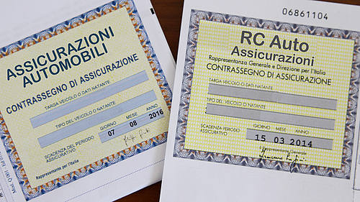
Insurance Mark until 2015

Slide 12
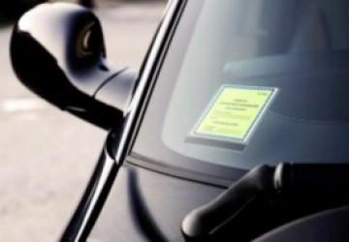
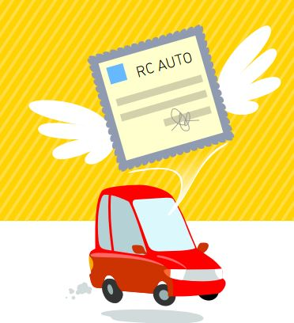

Slide 13
Insurance documentation, traditionally in paper form, has been replaced with electronic format.
Around 5 millions of vehicles in Italy are not provided of the compulsory insurance coverage. (around 10%)
Electronic Marks allow a better and faster control (cameras, distance controls), also they cannot be fake.
«Italian Information Center» holds a database where it is possible to check if a vehicle is covered by insurance (very helpful in case of accidents).

Slide 14
Electronic Risk Certification stops all the situations where, using a counterfeit certification, the insured party represents to insurance company a misleading risk profile to pay a lower insurance premium.
Companies can access directly to the «Risk Certifications Database» and have all informations and hystorical data about any insured party, so they can know what’s the true profile of risk and assign the corresponding bonus/malus class.
Reducing economic distortions in the market.

Slide 15
3) BLACK BOX and ALCOHOL LEVEL DETECTORS
Law 24.01.2012, n.1 introduced in Italy the first rules about black box (EDR – Event Data Recorder)
Now Italy has around 5 millions cars with a black box installed. First Country in Eurpean Union.
BB technical features have been decided by Italian Transportation Ministry in 2013.

Slide 18
New rules about BB have been recently introduced by law 04.08.2017, n. 124, providing the new art. 132-ter in Italian Insurance Code

Slide 23
So, it seems there are only benefits by installing a Black Box on our cars…

Slide 24

But there is also a DARK SIDE
Contributory negligence in accidents
Data acquisition errors
«Big brother» effect
Adverse selection of risks
Privacy

Slide 25
Almost 80% of traffic accidents are to be attributed to human failure.
In EU around 50.000 people are killed in traffic accidents every year.
Huge economical loss.
4) AUTONOMOUS AND SEMI-AUTONOMOUS VEHICLES
Around 80% of traffic accidents depend on human failure
Reduce human impact to reduce damages
Autonomous vehicles

Slide 26
Driverless cars and ADAS can make our roads safer.
Advanced Driver Assistance Systems (ADAS) are always more common on new cars, some of them became compulsory (ABS, Airbag…)
Even the most advanced ADAS still need the physical presence of a human driver behind the steering wheel

Slide 27
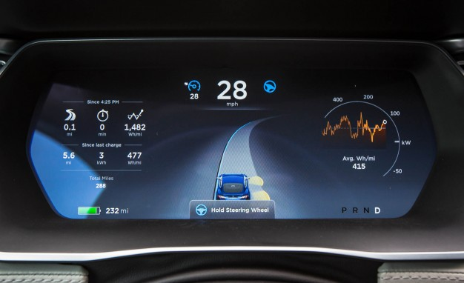

Slide 28
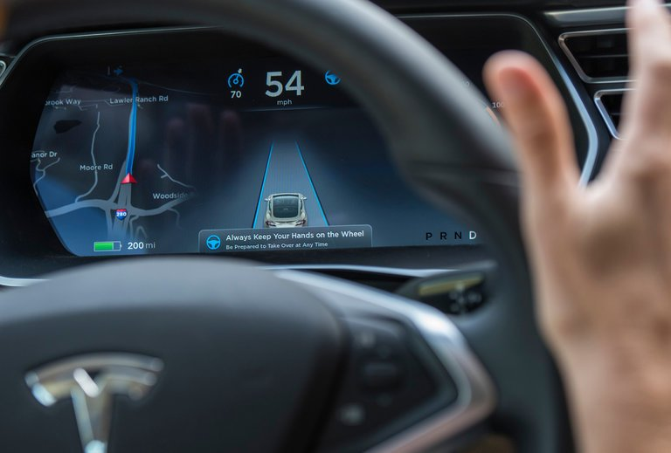

Slide 29
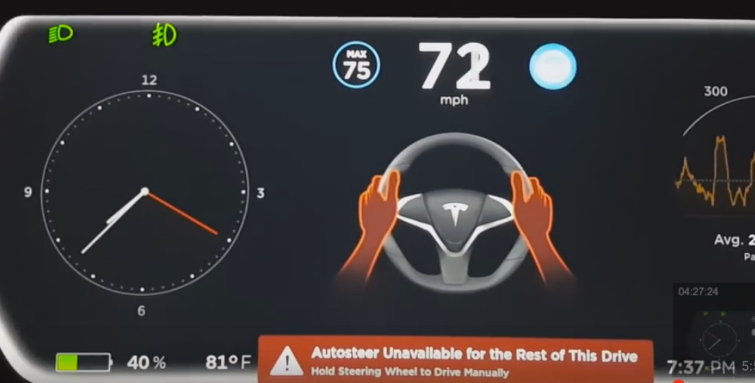

Slide 30
Art. 2054 c.c. - CIRCOLAZIONE DI VEICOLI
1. Il conducente di veicolo senza guida di rotaie è obbligato a risarcire il danno prodotto a persone o a cose dalla circolazione del veicolo, se non prova di avere fatto tutto il possibile per evitare il danno.
2. Nel caso di scontro tra i veicoli si presume, fino a prova contraria, che ciascuno dei conducenti abbia concorso ugualmente a produrre il danno subito dai singoli veicoli.
3. Il proprietario del veicolo, o, in sua vece, l' usufruttuario o l' acquirente con patto di riservato dominio, è responsabile in solido col conducente, se non prova che la circolazione del veicolo è avvenuta contro la sua volontà.
4. In ogni caso le persone indicate dai commi precedenti sono responsabili dei danni derivati da vizi di costruzione o da difetto di manutenzione del veicolo.

Slide 31
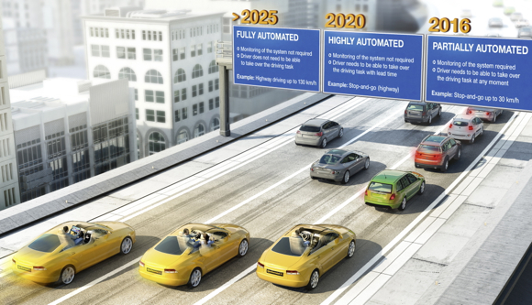
Future is not so far…

Slide 32
5) NEW QUESTIONS AND OPPORTUNITIES FOR THE INSURANCE INDUSTRY
For autonomous cars, in the case of an accident, there will only be the producer liability? Is it also a strict liability?
Without a human driver, there would still be strict liability for the vehicle owner?

Slide 33
New opportunities using Black Boxes:
«Pay as you go» or «Pay per use»
Pay how you drive
(taylor-made insurance)

